Slide 1
South Yorkshire
Regional Data pack
January 2023

Slide 2
Contents
3
Businesses in the region
companies in South Yorkshire
Businesses in the region
company size
Businesses in the region
company growth
Sector health and economy
Recruitment
recruitment and pay
Recruitment
education and experience
4
5
6
7
8

Slide 3
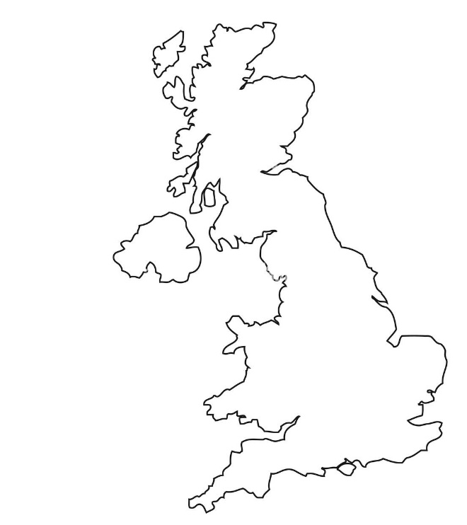
Businesses in the region
South Yorkshire
442
31,012
£1.7bn
Companies
Employees
Turnover (2021)
Sheffield
Doncaster
Rotherham
Barnsley
Local Authority
Sheffield
Doncaster
Rotherham
Barnsley
Companies
260
125
62
69
Employees
26,038
574
412
688
Turnover(£)
1.6bn
1.5bn
83.9M
268.5M

Slide 4



Businesses in the region
South Yorkshire
135 Sole traders 31%
172 Microenterprises 39%
45 Small enterprises 10%
20 Medium enterprises 5%
7 Large enterprises 2%
Sole trader
Microenterprises (1-9 employees)
Small enterprises (10-49 employees)
Medium enterprises (50-249 employees)
Large enterprises (250+ employees)

Slide 5
Businesses in the region
South Yorkshire
70
24
There has been a total cumulative growth of S&PA companies within South Yorkshire of 215 (95%) since 2015. Each year the area has seen a progressive increase in S&PA companies operating in the region.
Cumulative Company
growth
64% of the S&PA businesses operating within South Yorkshire are considered in the start-up stage of business growth showing the majority of companies operating in the sector within South Yorkshire typically don't have a fully developed business model and potentially lack adequate capital to move onto the next phase of business. Just 5% of these business are considered scaleups and have average annualised return of at least 20% in the past 3 years and had at least 10 employees. 16% of S&PA business in the region are considered Established showing they are reputable within the sector and have a developed customer base. This shows the maturity of the S&PA sector in the region.
There was a steep increase in the number of S&PA employees within South Yorkshire in 2018, with employee numbers since falling, but remaining above pre-2018 numbers. There were no new large businesses incorporated in South Yorkshire within the S&PA sector during 2018.
Cumulative Employee
growth

Slide 6

Sector health and economy
South Yorkshire
Turnover across the S&PA sector has seen a decline within South Yorkshire over recent years following a growth period 2016-2019 to £2.1bn. The sector now turns over less than it did 5 years ago, at £1.7bn showing a decrease in the size of the sector within the region.
Turnover (2021): 1.7bn
The annual net worth of the S&PA sector within South Yorkshire saw an increase from previous years in 2017 however, has decreased annually since showing the negative direction of the economic health of the sector during recent years.
£500M
Over the past 6 years the S&PA sector within South Yorkshire has consistently had at least 29% more liabilities than assets, with the totals for each tending to increase and decrease in situ. 2016/17 saw the smallest margins between assets and liabilities that the region’s S&PA sector has seen and this has worsened since, reaching 118% more liabilities than assets in 2020. That said, liabilities have reduced since 2019, but by less than the reduction in assets.
£400M
£300M
£200M
£100M
Total liabilities (2021): 2bn
Total current assets (2021): 957.3M
2016
2017
2018
2019
2020
2021

Slide 7
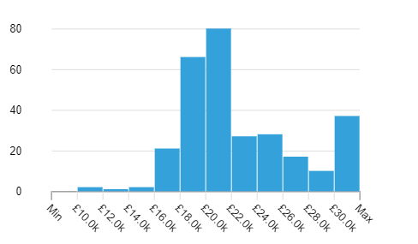
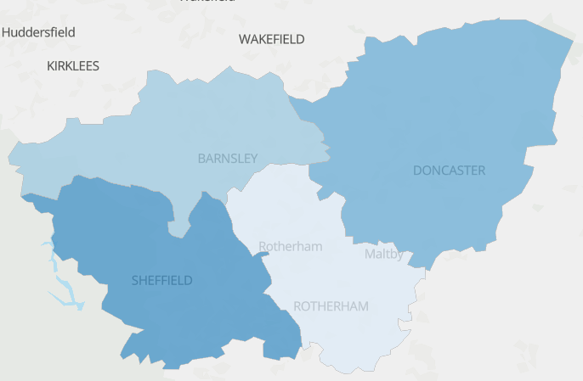
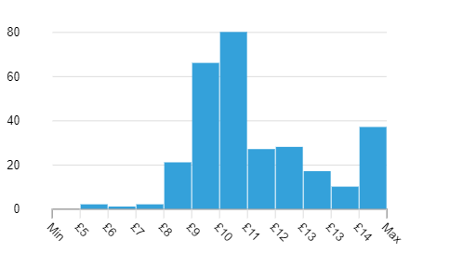
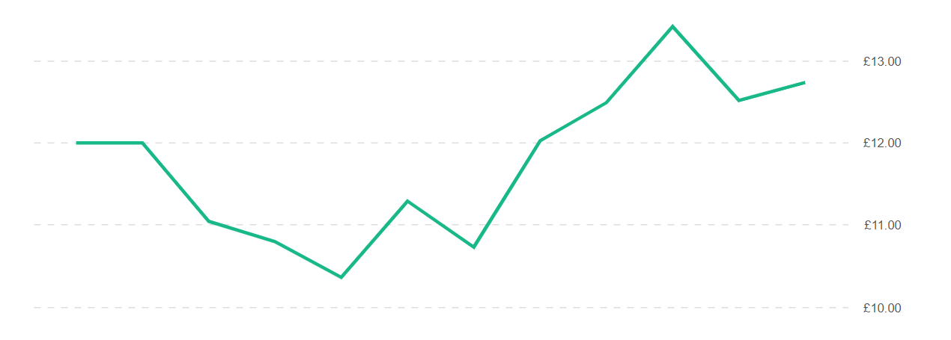
Recruitment
South Yorkshire
The average advertised salary in 2022 across all S&PA occupations within South Yorkshire was £23k. There is a salary range of £10k to £79k with 2% earning the lower of the salary range and 8% earning at the highest. Around 30% of the S&PA workforce in South Yorkshire earn within the median salary band here, of £19k-£22k.
When looking at hourly pay, the median average was £11.05/hr. This ranges from £5/hr to £38/hr.
Sheffield was the highest paid LA within South Yorkshire with the workforce earning on average £25k or £12.03/hr.
Job postings by Local Authority over 12 months
Posting by LA Dec ‘21 – Dec ’22
Sheffield 700
Doncaster 267
Barnsley 176
Rotherham 174
Regional job postings over 12 months
Advertised wage trends show that advertised salaries have increased by 6.2% in the past 12 months, with a peak of £27.9k annually or £13.42/hr

Slide 8
Recruitment
South Yorkshire
Education & experience required by employers
Top 10 companies for recruitment of S&PA roles within South Yorkshire (2022)
1 – Places Leisure
2 – Virgin Active
3 – Puregym
4 – The Gym Group
5 – Sheffield Hallam University
6 – Places for People Group Ltd.
7 – Next Level Sports Group
8 – University of Sheffield
9 – NHS
10 – Nuffield Health
GCSE or equivalent 11%
A-level or equivalent 5%
Foundation/HNC/HND or equivalent 1%
Bachelor’s or equivalent 5%
Master’s or equivalent 0%
Ph.D. or equivalent 0%
% of job postings in the region that require this level of education or experience
No minimum experience 88%
0-1 years 4%
2-3 years 5%
4-6 years 1%
7-9 years 0%
10+ years 2%

Slide 9
Stakeholders
South Yorkshire
HE
FE
Active Partnerships
Chamber of Commerce
Sheffield Hallam University
University of Sheffield
University of Huddersfield
Balby Carr Community Sports College
Barnsley College
Dearne Valley College
Doncaster College
Sheffield College
Thomas Rotherham College
Yorkshire Sport Foundation
Sheffield Chamber of Commerce
Barnsley & Rotherham Chamber of Commerce
Doncaster Chamber of Commerce

